Slide 1
Safeguarding children with SEMH needs 13th November 2020 www.carolyneyre.com

Slide 2
Disability or need Increased risk by category
Speech & language 5 x physical abuse & neglect
3 x sexual abuse
Developmental delay 2 x neglect or emotional abuse
~4 x physical abuse
Behavioural disorders 7 x emotional, physical or neglect
3 x sexual abuse
Deaf or hearing impaired 4 x physical abuse
2 x emotional or neglect
Sullivan & Knutson 2000

Slide 3
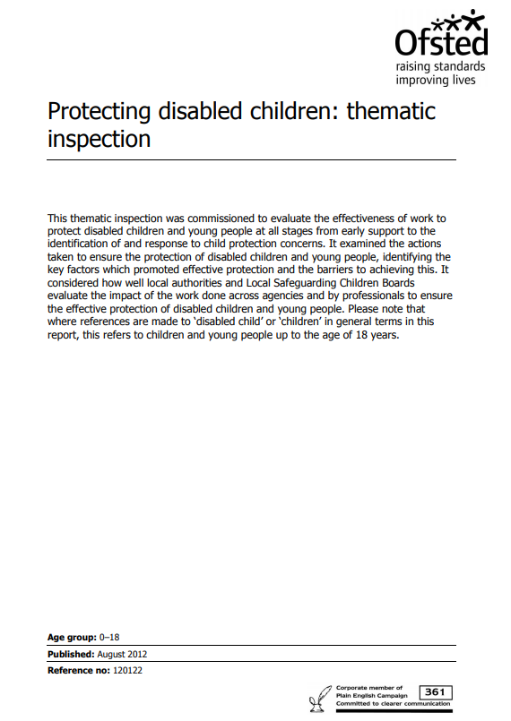
Statistics
14% of all Children in Need are disabled but only 3.7% of children with a CP plan are disabled (4 x less likely)
Disabled children make up 3.7% of all children subject to CP plan but 14% of SCRs (4 x more likely)
“The impact of neglect on disabled children is therefore significant. This is not always recognised in time. In many of the child protection cases examined by inspectors, where neglect was the key risk, children had previously received support as children in need for a long time. Despite the lack of improvement for the child there were delays in recognising that the levels of neglect had met the threshold for child protection”
Notes:
It doesn’t happen to disabled children 2003
Safeguarding disabled children 2009
We have the right to be safe 2014
Ofsted 2012

Slide 4
Increased risk or impaired response??
Assumptions about capacity
Diagnostic overlay
Rule of optimism
Parent / carer as advocate
Reluctance to challenge parents
Positive stereotyping
Skills gap
Lack of time / resources

Slide 5
Reduced access to RSE / PSHE
Assumptions about capacity
More time spent online
Thresholds
Rule of optimism
Diagnostic overlay
Parent / carer as advocate
Less likely to be believed
Adultification
Infantilising or over-protection
Reluctance to challenge
Halo effect
Over-reliance on verbal disclosure
Thresholds
More likely to be excluded
Learned compliance
Notes:
Seen as a ‘bad’ child

Slide 6
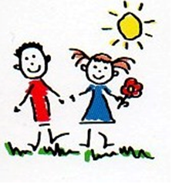
Safeguarding – a definition
KCSIE (DfE 2020) says that safeguarding and promoting the welfare of children is:
Protecting children from maltreatment;
Preventing impairment of mental and physical health or development;
Ensuring that children grow up in circumstances consistent with the provision of safe and effective care; and
Taking action to enable all children to have the best outcomes

Slide 7
Ofsted on safeguarding
“Safeguarding is not just about protecting children, learners and vulnerable adults from deliberate harm, neglect and failure to act. It relates to broader aspects of care and education, including:
children’s and learners’ health and safety and well-being, including their mental health
meeting the needs of children who have special educational needs and/or disabilities
the use of reasonable force
meeting the needs of children and learners with medical conditions
providing first aid
educational visits
intimate care and emotional well-being
online safety and associated issues
appropriate arrangements to ensure children’s and learners’ security, taking into account the local context

Slide 8
All staff should …
Be aware of the local criteria for action, including early help and their role in providing this
Be aware of the signs and indicators of abuse and neglect (as described in ‘what to do if … ‘ 2015)
Understand that mental health issues may be an indicator of abuse, neglect or wider safeguarding risks
Know what to do if a child tells them s/he is being abused, and never promise to keep it secret
“All staff should be trained to manage a report”
Be aware that children with a social worker may need additional pastoral / academic support
Know how to make a referral and understand that they may be expected to contribute to any assessment

Slide 9
Mental health & wellbeing
“Staff are well placed to identify behaviour suggestive of a mental health problem or being at risk of developing one”
All staff should have an awareness of mental health problems as an indicator of abuse, neglect or exploitation
They should understand the lasting impact of abuse, neglect and ACEs on mental health, behaviour & education
Where there is a safeguarding concern, follow the child protection procedure

Slide 10
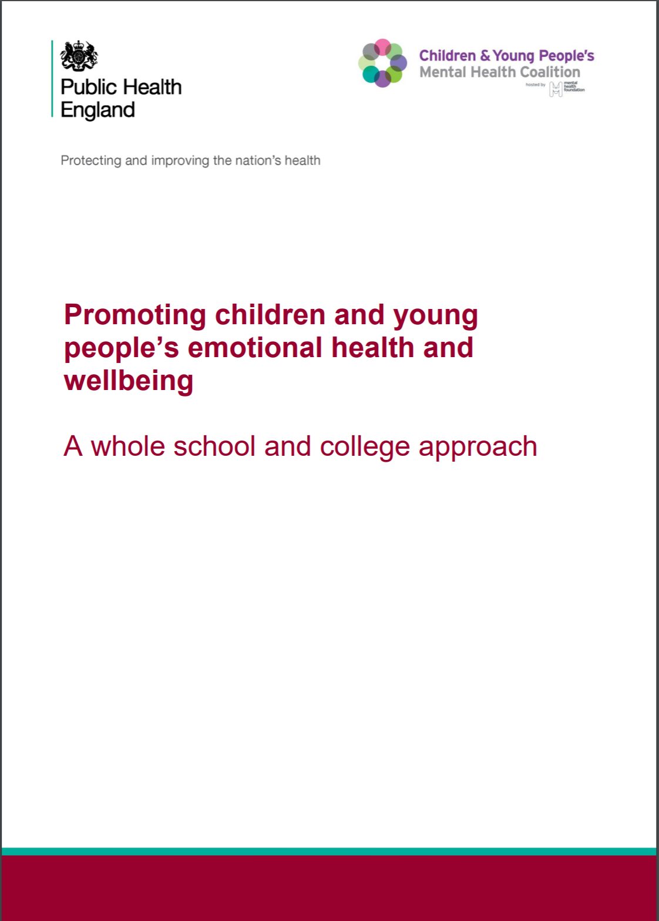
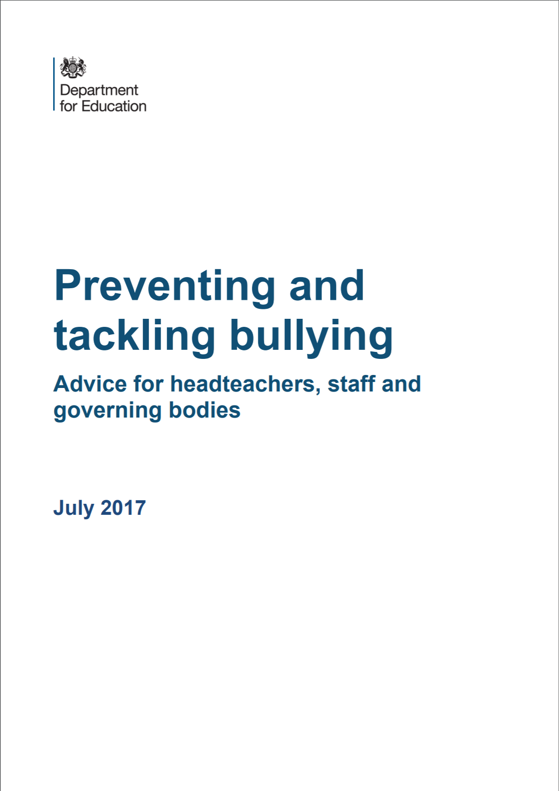
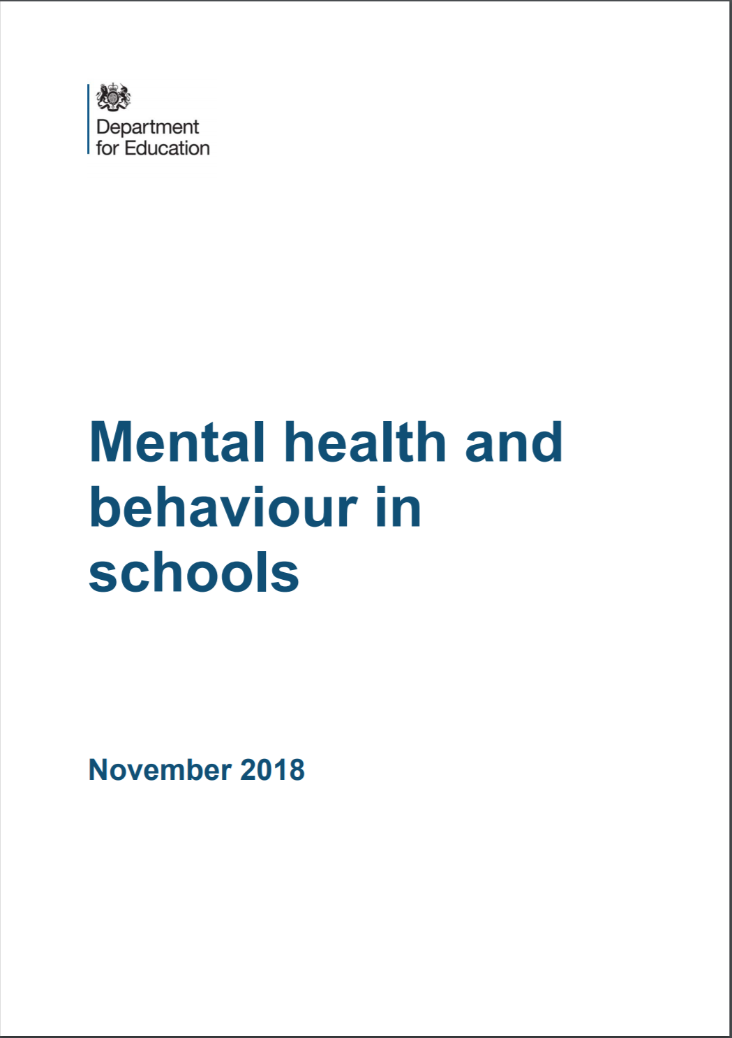
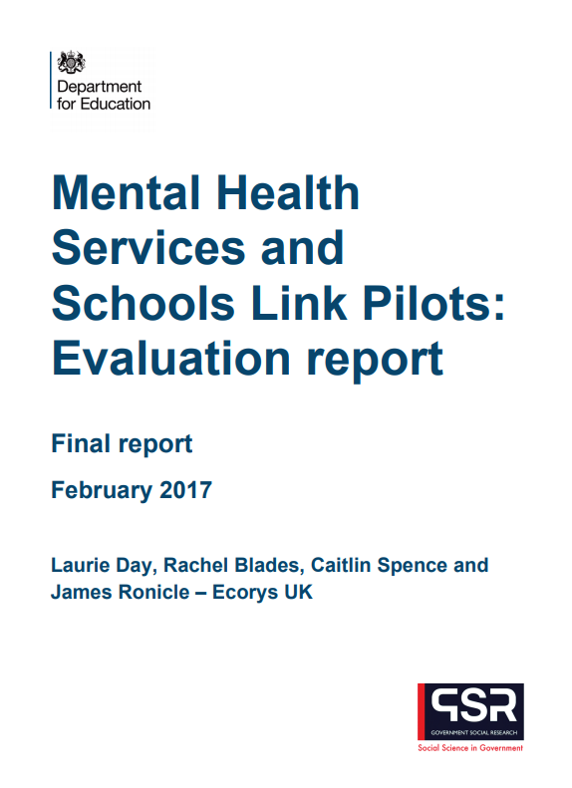
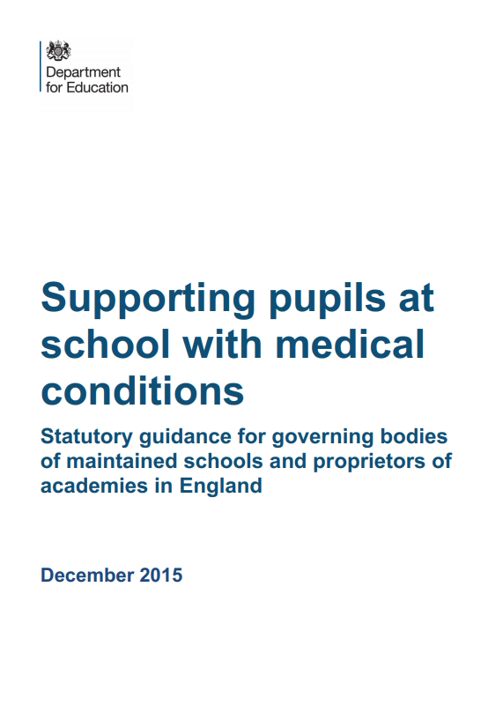
Resources

Slide 11
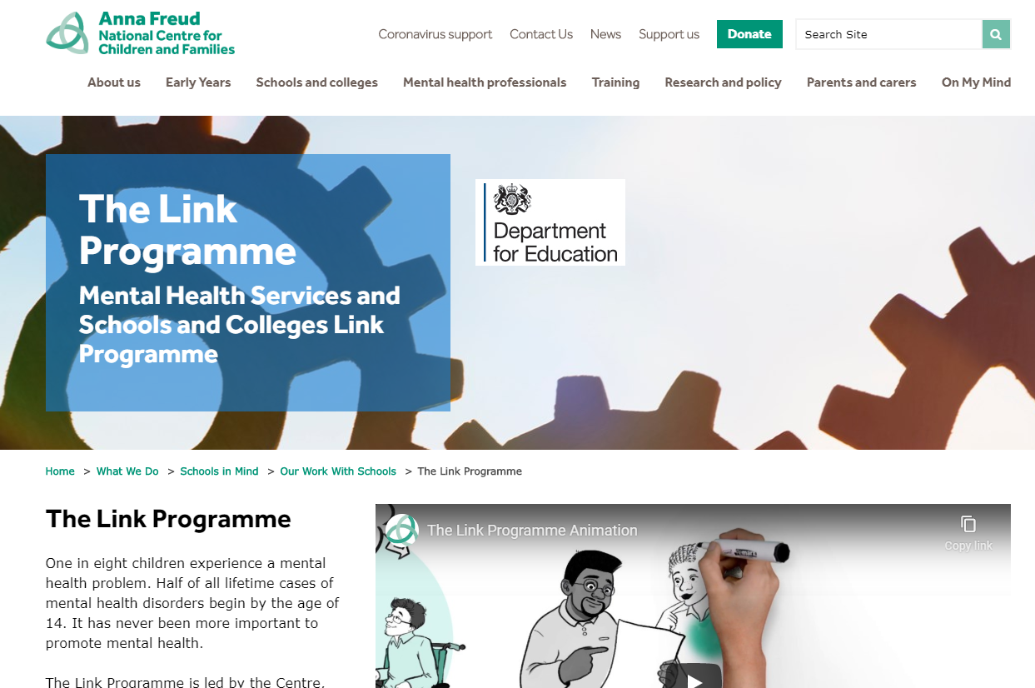
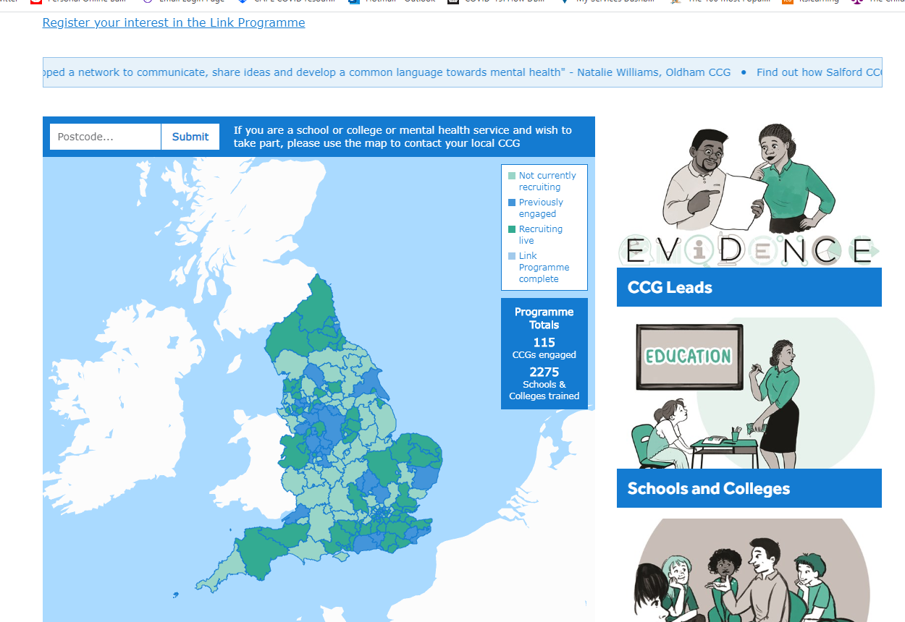
Resources

Slide 12
SEND – KCSIE 2020
“Children with special educational needs and disabilities can face additional safeguarding challenges … These can include:
assumptions that indicators of possible abuse such as behaviour, mood and injury may relate to the child’s disability without further exploration;
being more prone to peer group isolation than other children;
the potential for children with SEN and disabilities being disproportionally impacted by behaviours such as bullying, without outwardly showing any signs; and
communication barriers and difficulties in managing or reporting these challenges”

Slide 13
KCSIE 2020 - continued
“Governing bodies and proprietors should ensure that their child protection policy reflects the fact that additional barriers can exist when recognising abuse and neglect in this group of children”
To address these additional challenges, schools and colleges should consider extra pastoral support for children with SEND”
“When using reasonable force in response to risks presented by incidents involving children with SEN or disabilities or with medical conditions, schools and colleges should in considering the risks carefully recognise the additional vulnerability of these groups”

Slide 14
Contextual safeguarding
‘Working together to safeguard children’ & KCSiE 2018 introduced a new concept of contextual safeguarding to describe the risks that children and young people face from their peers or in the wider community including:
Online safety
Sexual exploitation
Criminal exploitation
Radicalisation
Trafficking
KCSIE 2020 refers to this as extra-familial harm
Notes:
Staff need to be aware of CS and Des staff need to consider contextual safeguarding when deciding whether to make a referral etc

Slide 15
WT 2018
“Assessments of children in such cases should consider whether wider environmental factors
are present in a child’s life and are a threat to
their safety and/or welfare.”
Image: Contextual Safeguarding Network

Slide 16
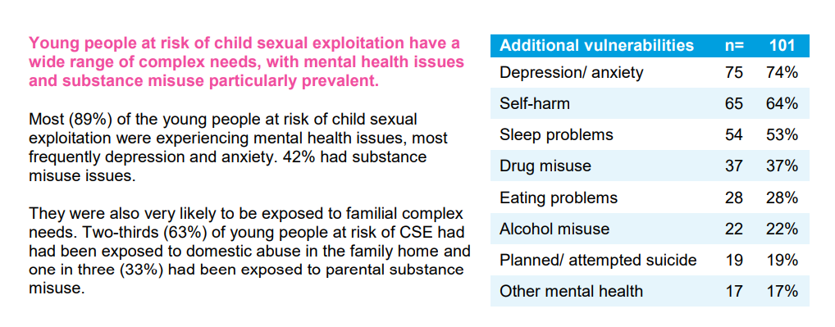
Statistics - CSE
www.safelives.org.uk 2015
Notes:
Ofsted 2012

Slide 17
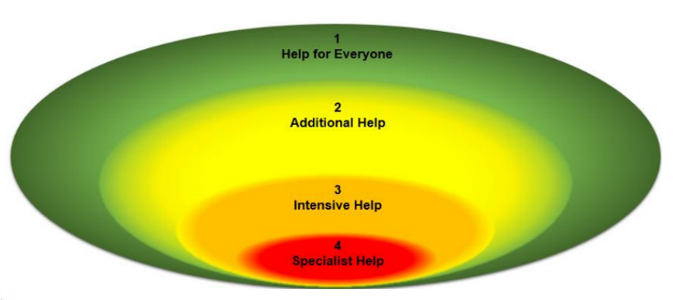
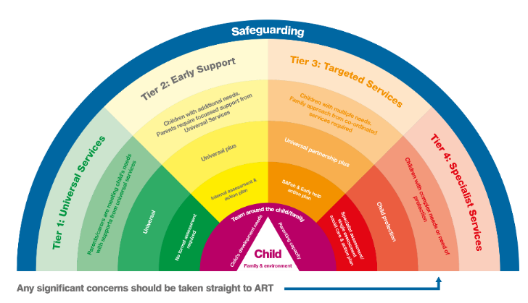
Criteria for action

Slide 18
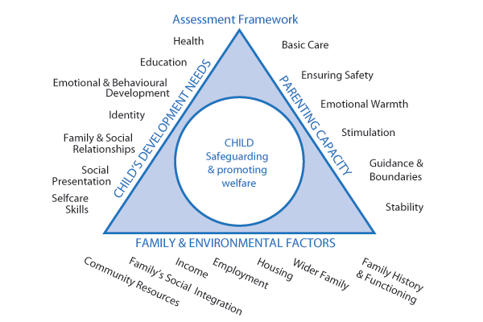
Statutory framework for assessment
Principles
Timeliness Transparency Proportionate

Slide 19
Teaching children to be safe
“Schools and other children’s service providers play an important role in making children and young people aware of behaviour towards them that is not acceptable, and of how they can help keep themselves safe. For example, pupils should be taught to:-
recognise and manage risks in different situations and then decide how to behave responsibly
judge what kind of physical contact is acceptable and unacceptable
recognise when pressure from others (including people they know) threatens their personal safety and wellbeing and develop effective ways of resisting pressure.”

Slide 20
Additional measures for children with SEND
making it common practice to help them make their wishes and feelings known in respect of their care and treatment;
ensuring that they receive appropriate personal, social & health education (including relationships & sex education);
making sure that all children know how to raise concerns, and giving them access to a range of adults with whom they can communicate - those with communication impairments should have available to them at all times a means of being heard;
an explicit commitment to, and understanding of children’s safety and welfare among staff;
clear understanding that disclosure is not always verbal - children with communication barriers may sign or show instead

Slide 21
Additional measures for children with SEND
close contact with families, and a culture of openness on the part of services
guidelines and training for staff on good practice in
intimate & personal care
understanding challenging behaviour
use & impact of physical / restrictive intervention
consent to treatment
anti-bullying strategies; and
sexuality and sexual behaviour among young people, especially those living away from home

Slide 22
“It is easier to build strong children than to repair broken men”
Frederick Douglass

