Slide 1
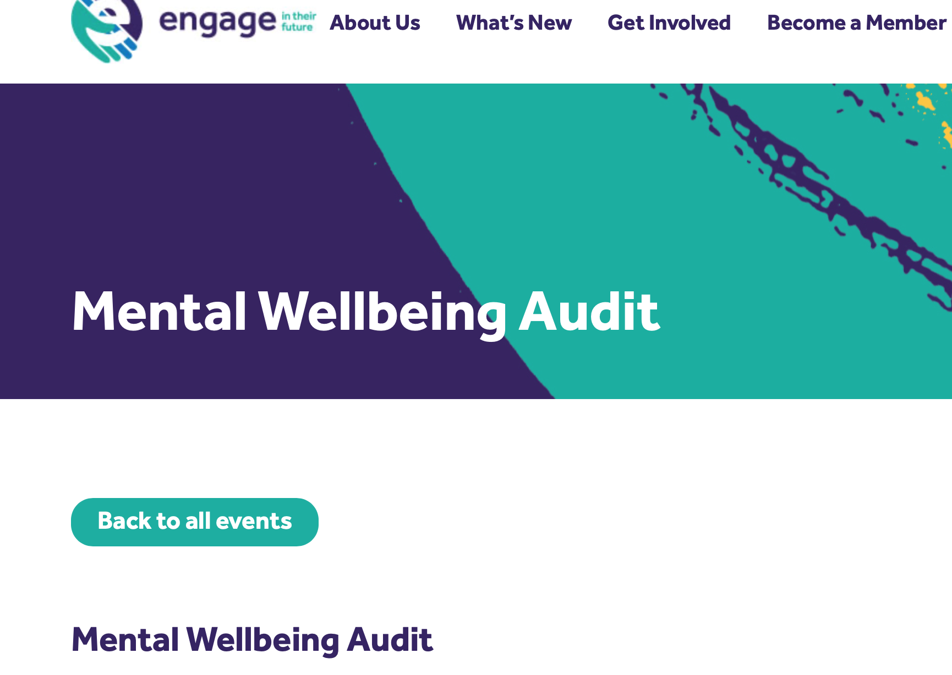
Igniting emotional health and wellbeing through
connection, positivity, hope and optimism.
Engaging with emotional health and well being
The Engage Whole School/Academy/LA/Trust
Mental Wellbeing Audit
January 20th 2022
Sharon Gray OBE
Wholehearted Learning
www.sharongray.org
sharongray.co@gmail.com
Richard Boyle M.Ed
Education Director
Accompli: Professional Development
www.accompli-pd.co.uk

Slide 2
Sharon Gray OBE NLE
Wholehearted Learning
www.sharongray.org
sharongray.co@gmail.com
@SgraySharon
28 years experience working with children and young adults, workforce, systems levels
Member of the Youth Justice Board
Chair of the Youth Advisory Network Organisations MoJ
Member of Team Teach Advisory Board
Independent Consultant - Wholehearted Learning
Co-opted National Committee Member - ‘engage in their future’
SEND/MITA Reviewer - London Leadership Strategy, Challenge Partner
Headteacher for 22 years;
6 in a mainstream school
16 in SEMH special schools - primary and secondary, day and residential
Experience of supporting and working in;
alternative provision, secure units, psychiatric secure, prison settings
British Schools Overseas Accredited Inspector
Experienced Additional Ofsted Inspector - 9 years
Medway Improvement Board - Safeguarding Review - Ministry of Justice
ecl Uk Lead - Enhancing Children’s Learning International Charity
CYP’s Mental Health and Wellbeing ‘Future in Mind’ - Taskforce Member
Code of Practice - Taskforce Member

Slide 3
Previously Chair of NASS (National Association of Independent and Non-Maintained Special Schools) and formerly Vice Chair of Engage (Engage in Their Future)
Richard Boyle has worked in mainstream and non-maintained residential special education since 1983.
Richard was previously Principal and CEO of Muntham House School the focus of the BAFTA award winning film ‘Last Chance School’.
In 2019 Richard was awarded the Outstanding Impact Award by NASS.
Richard has represented special schools in local, regional and national forums and is currently a Consultant supporting special schools in the UK.
AREA OF EXPERTISE
Children and Young People: positive behaviour management; curriculum management; teaching and learning; Residential Care practice;
Leadership, Strategy and Management: vision and change management; legislative and policy impact; contractual and fee negotiations; local and national impact
School development and improvement: going beyond Ofsted; setting up a new school or community.Staff,
Governor and Trustee Performance Management: developing sustainable, mutual and resilient practice; building capacity;
School development and improvement: going beyond Ofsted; setting up a nStaff, Governor and Trustee Performance Management: developing sustainable, mutual and resilient practice; building capacity;
Richard Boyle M.Ed
Education Director
Accompli: Professional Development
www.accompli-pd.co.uk

Slide 4
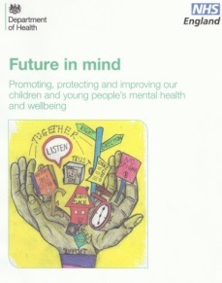
Personal and professional learning is key
In Sept 2014, the government established a children and young people’s Mental Health and Wellbeing Taskforce.
Its report, which was published jointly by the Department of Health (DoH) & NHS England, is called:
Future in mind – Promoting, protecting and improving children and young people’s mental health and wellbeing.
10% of CYP aged 5-16 have a mental health disorder - 2014
This means that in an average class
of 30, three children will have a
diagnosable mental health disorder.
We know that this number has increased significantly during the pandemic - 20-40%

Slide 5
In addition, a further 10% will have problems that affect their day to day living, behaviour, achievement and happiness but many go undiagnosed. 75% of life time mental Health disorders begin before the age of 18.
For those aged between 15 - 24, death by suicide is the second most common cause of death accounting for 19% of all deaths in this age group.
200 school aged children take their own life each year, that’s almost 4 children each week.
The wider economic cost of Mental Health in England have been estimated above £105 billion each year.

Slide 6
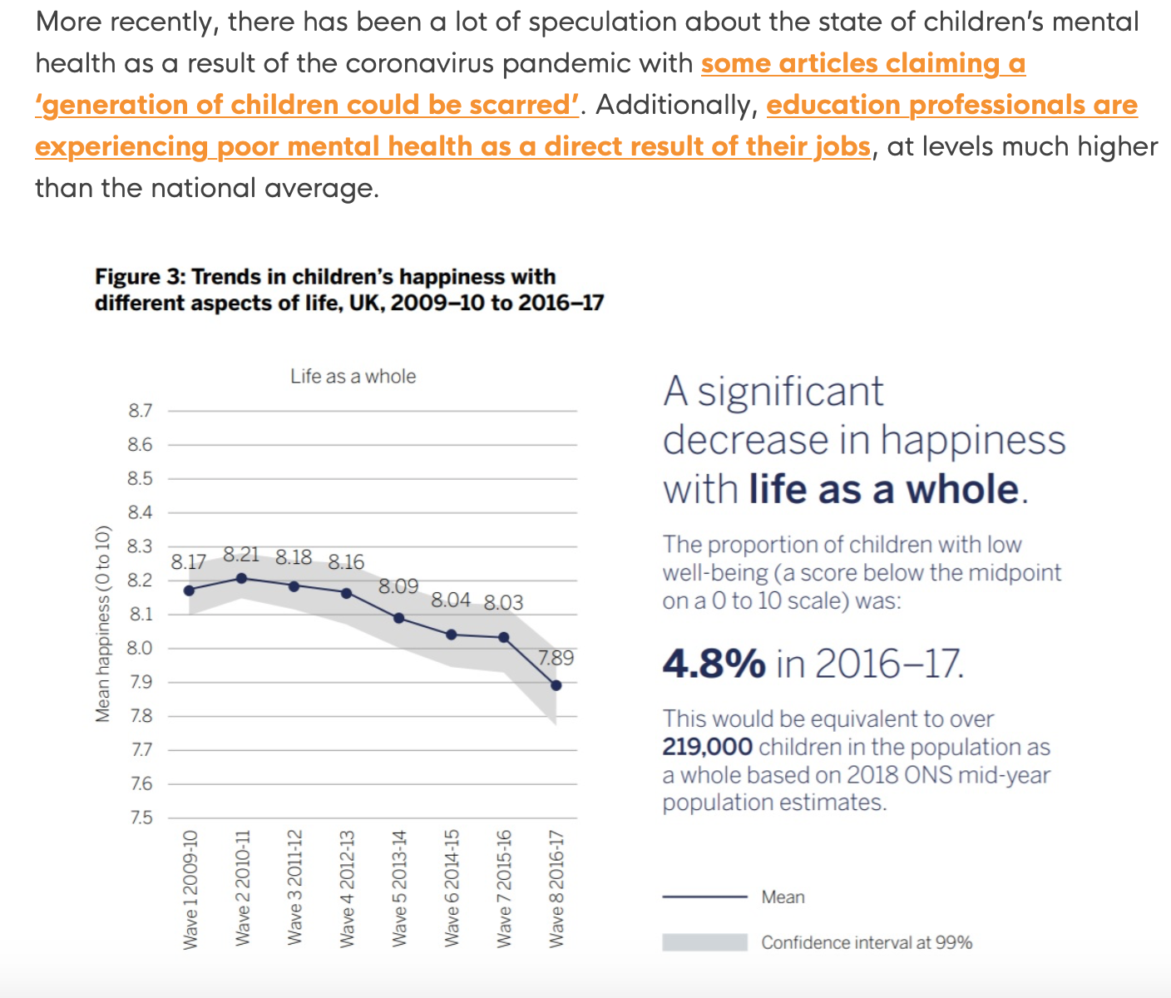
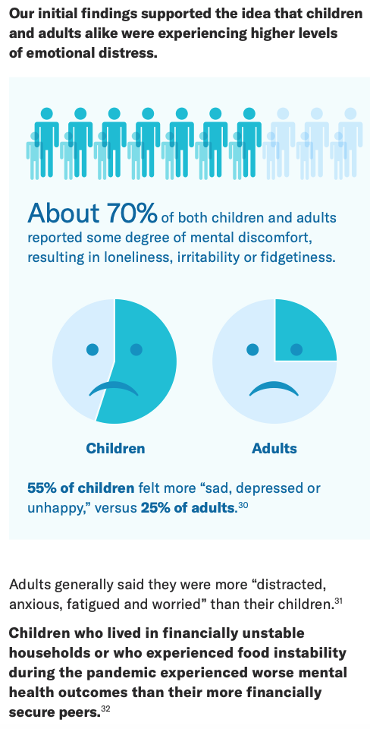

Slide 7
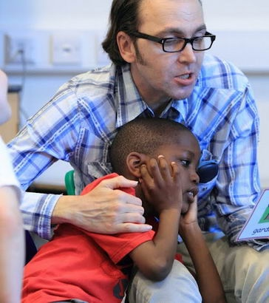
40% of children experience trauma by the age of 18.
That means in a classroom of 30 children 12 could have potentially experienced trauma that impacts the way they feel about themselves, the way they learn and the way they interact with others.
The biggest aid to helping support these children is to really
understand what the impact of trauma does to children.
…………………..how does it feel for a child, what practically can
we do to help them and what changes need to be made in our learning
environment, our schools to accommodate and authentically include them?
Report published 4th July - ‘One in Six’ _ Anne Longfield
An estimated 2.1 million of England’s 11.8 million children – one in six – are living in families where there are risks so serious that some level of intervention or help is necessary.
However, 1.6 million children are thought to be “invisible” to the system – living in vulnerable situations but not receiving any help.

Slide 8
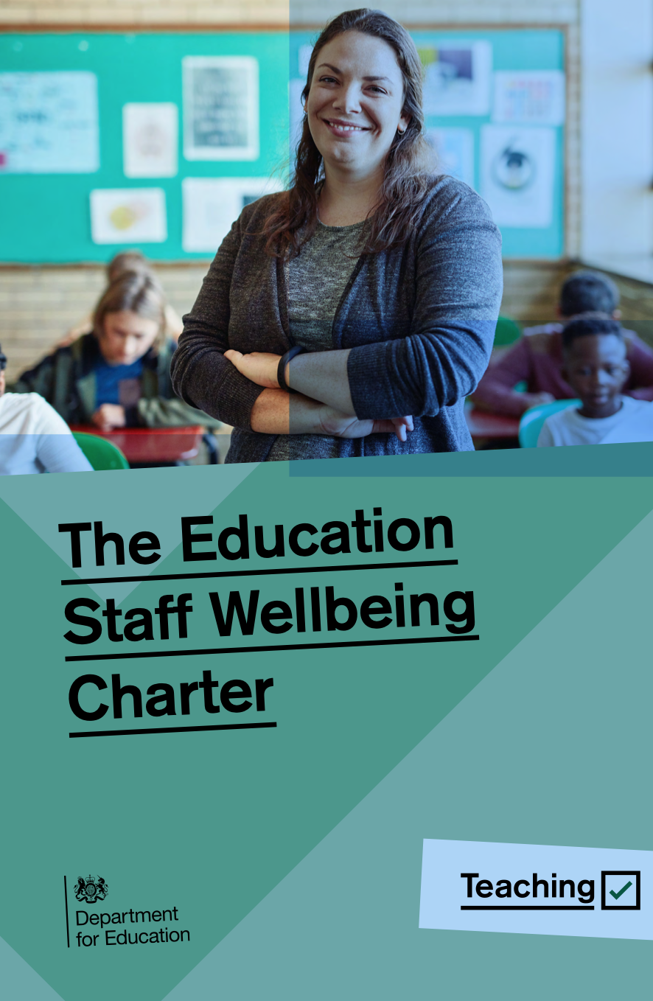
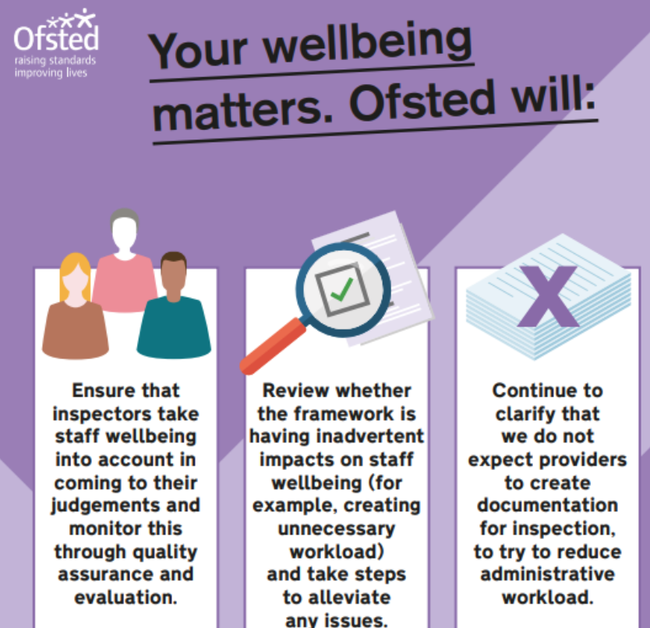
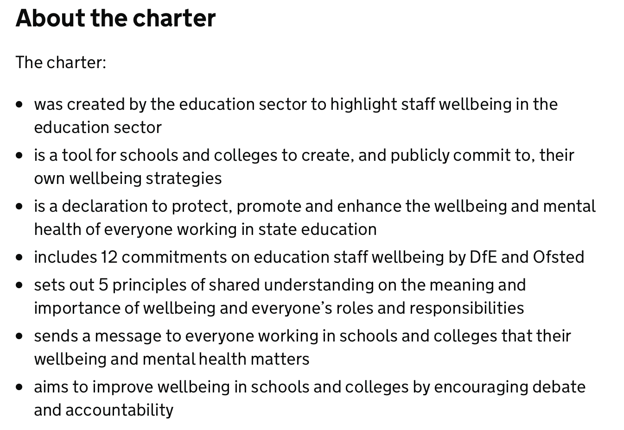

Slide 9
Behaviour has meaning………..
“It makes a great deal more sense, of much of the seemingly unreasonable behaviour or outrageous behaviour of many children if one bears in mind that they are often doing to others what they experience as being done to them, both externally and internally”
(Boston 1983)
Notes:
Steph

Slide 10
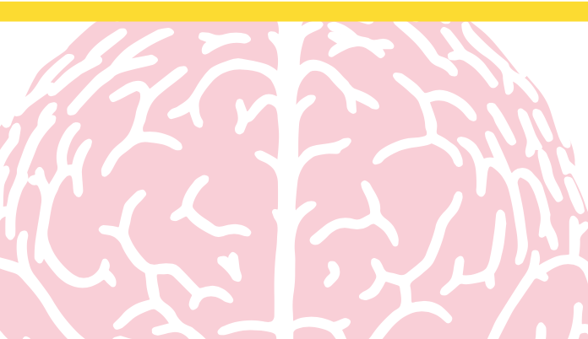
Among this century’s medical and social breakthroughs is the recognition that this statement is a complete fallacy.
Perhaps it’s our new awareness of the effects of ongoing stress, or perhaps it’s the mixed results of behaviourally based therapies that has led us to see there are aspects of our health which are outside of our conscious control.
Taking a fresh look at the way we develop and the way our brains connect with our bodies can give us insights into how we can become our best self.

Slide 11
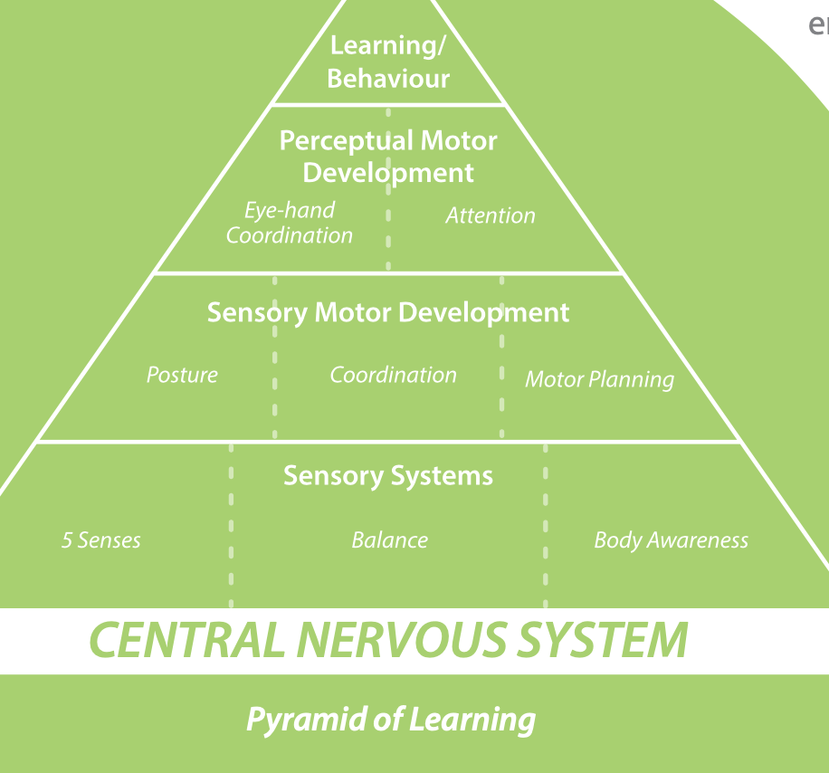
It happens gradually, with higher brain skills developing after a solid sensory and emotional foundation is set.
Sometimes the sensory foundation isn’t fully developed, sometimes our emotional regulation gets shaken by life’s changes – what happens then?
Well, the bottom line is that we don’t function quite as well.
Higher brain functions such as learning, communication, and focus are dependent upon how well we are able to process incoming information at the sensory and emotional levels.

Slide 12
Desperately seeking homeostasis
Finding emotional balance means developing a nervous system which, like a healthy body, has the flexibility to respond appropriately with action (‘fight or flight’) or with relaxation (‘rest and restore’).
A lot is made of our need for more emotional balance these days, and for good reason. Those of us who are otherwise healthy are finding that stress has crept into our life and is disrupting our sleep, our work, and our relationships.
If we are worried and feeling unsafe our defences go up, and whatever activity or therapy we are engaged in, becomes ineffective.
Those of us challenged by learning and developmental difficulties, or mental health issues, are realising that improvement is dependant on our emotional state.

Slide 13
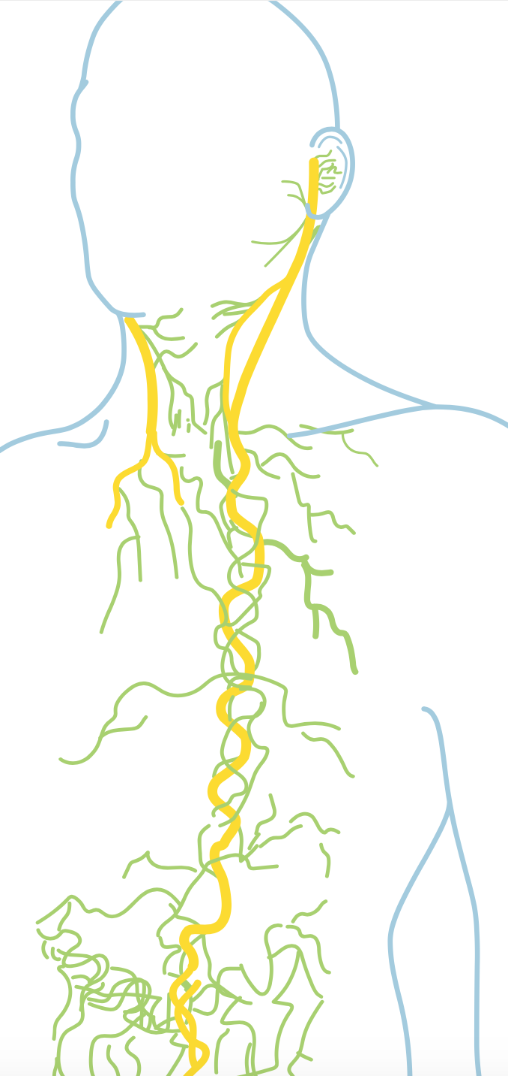
Connecting with the
vagus nerve
The Autonomic Nervous System (ANS) is at the centre of our self-regulating process, influencing important systems in our body, including our heart, respiration rate, and digestion. It is constantly sending our body signals, getting us ready to react to various situations at all times.
Our ANS is, in large part, governed by a nerve which is hugely important to our overall well-being: the vagus nerve.
The vagus nerve is the longest cranial nerve in the body - stretching from the brainstem all the way down to the stomach.

Slide 14
We feel immobilised, shut down, and unable to connect. This is an evolutionary adaption for survival, it’s built into our nervous system. The ventral vagal pathway responds to positive cues and supports feelings of being safe and relaxed.
Two pathways of the
vagus nerve
When we are firmly grounded in the ventral vagus, our heart rate is slower, our blood pressure drops and our defences are down. In this state, we are calm and regulated. We are ’available’ - both physiologically and psychologically - for change, for challenge, the optimal case for connection, engagement and learning.
The vagus nerve is divided into 2 parts - the dorsal and ventral vagus.
The dorsal vagal pathway responds to cues of extreme danger. An example of the dorsal vagus taking control is stage fright.

Slide 15
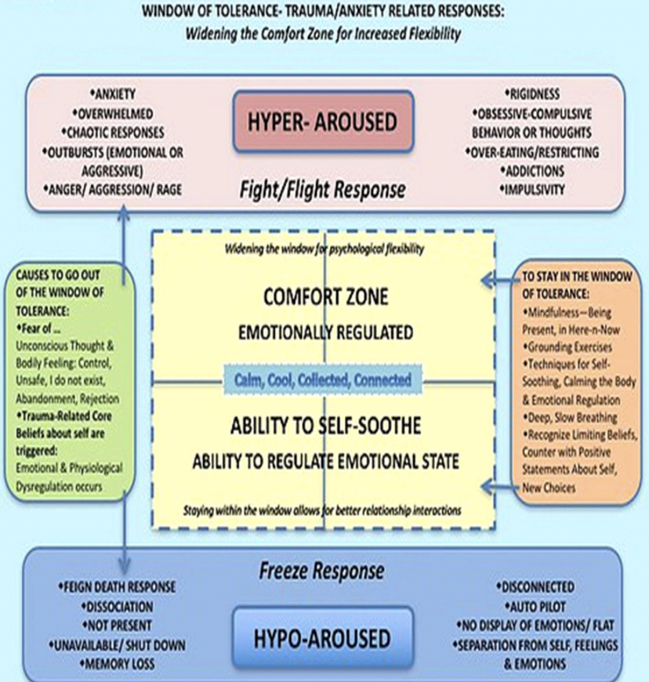
Our window of tolerance is a state of optimal arousal and social engagement.
In this state:
we feel safe and at ease
we feel comfortable with everything that is going on around us and within us
the myelinated branch of our parasympathetic nervous system is regulating our breathing, heart rate and digestion
we’re able to engage socially with others, to integrate emotions/experiences, and to think and learn
We’re not triggered into fight/flight or freeze.

Slide 16
Robin Banerjee – University of Sussex
http://www.sussex.ac.uk/psychology/cress/tools
Questionnaire elicits positive and negative nominations for classmates
Antisocial behaviour
Social isolation
Sociograms
Notes:
Robin Banerjee
Sociogram
Uses questionnaire
Years 1 and 2 1. My Feelings - positive social experiences at school - negative social experiences at school - negative emotions (e.g. feeling sad, worried, or scared) at school 2. My Class peers that they: - most like - least like Years 3 and above 1. My Feelings eg anger, anxiety, self-perceptions 2. My Class eg see as kind and cooperative, disruptive etc
LABELS
Rejected
Neglected
Average – don’t stand out
Popular
Controversial - children" receive both highly positive and highly negative ratings from their peers.

Slide 17
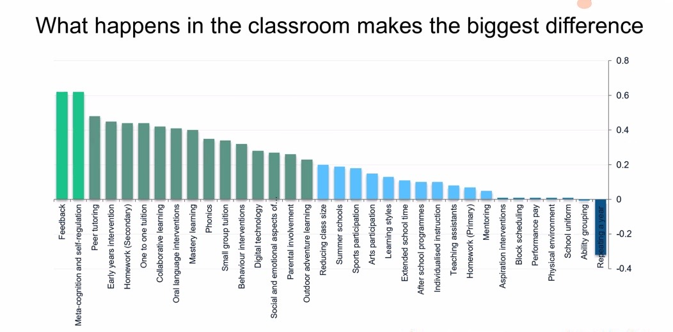
Reltional
Relational Approaches
StructuralApproaches

Slide 18
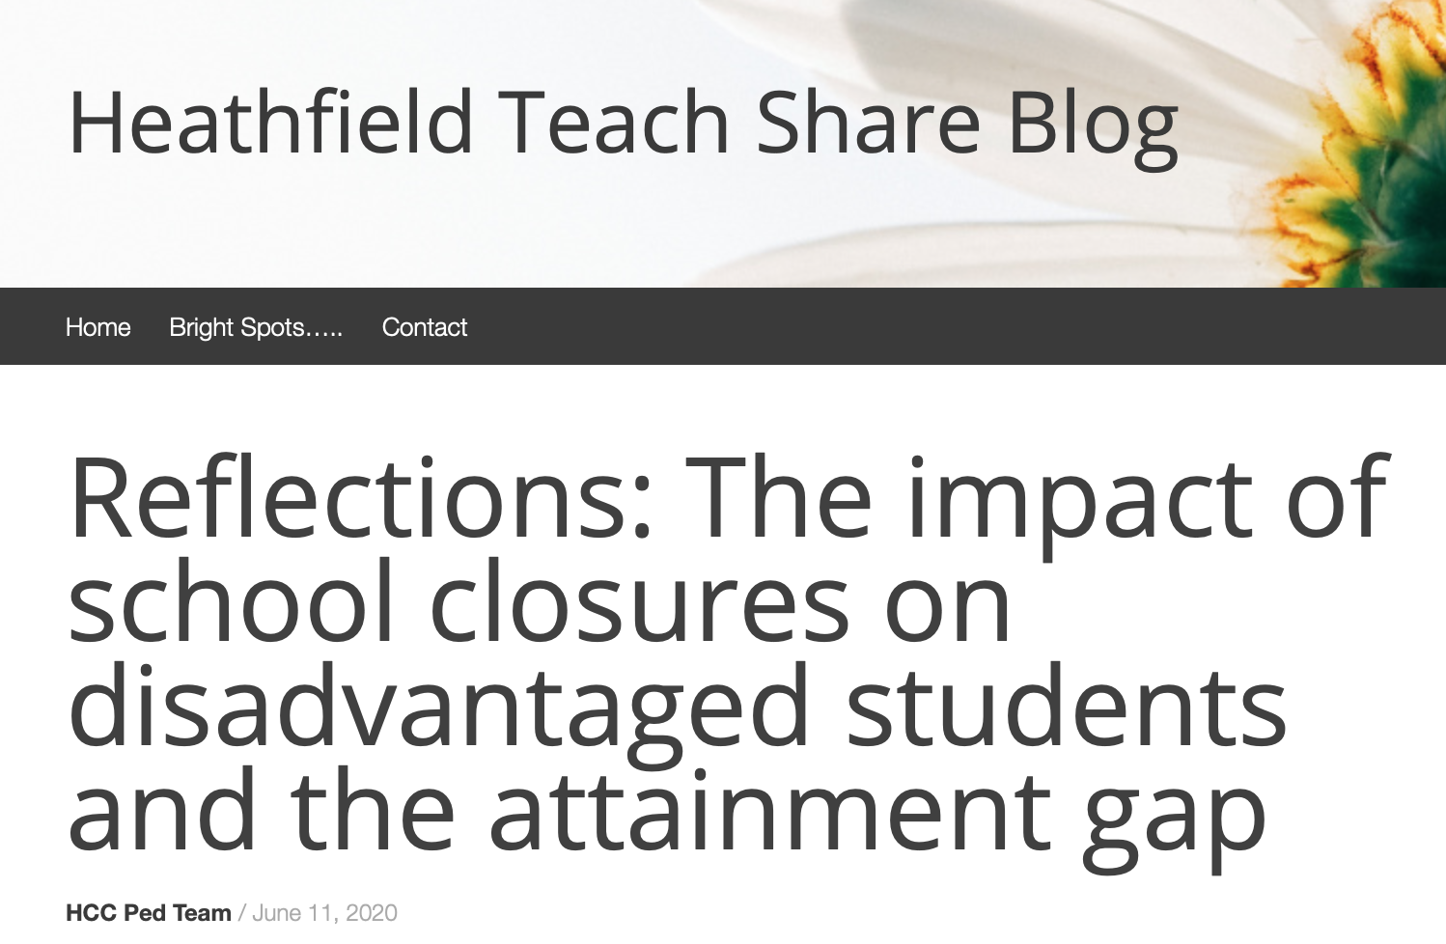
‘It’s a thousand little moments that lead to great attainment for disadvantaged pupils rather than those big, shiny interventions.’
Marc Rowland
Clearly Marc is suggesting that the majority of these ‘golden moments’, as he puts it, are happening in the classroom, but the impact of these interactions all over the school must not be underestimated.
Great
teaching
Reltional
Great
teaching
Relational Approaches

Slide 19
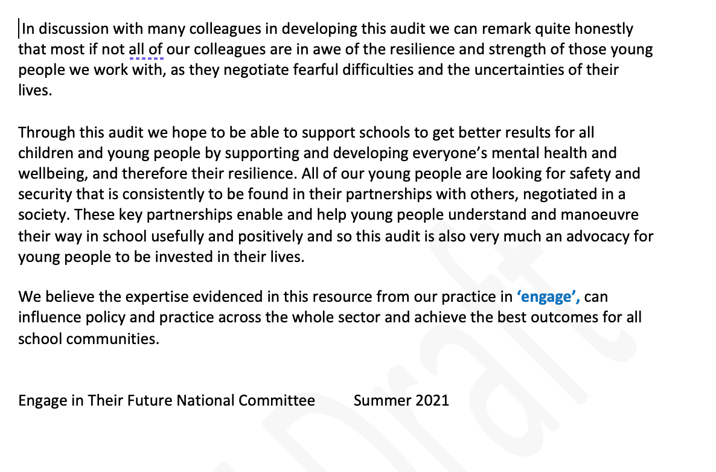

Slide 20
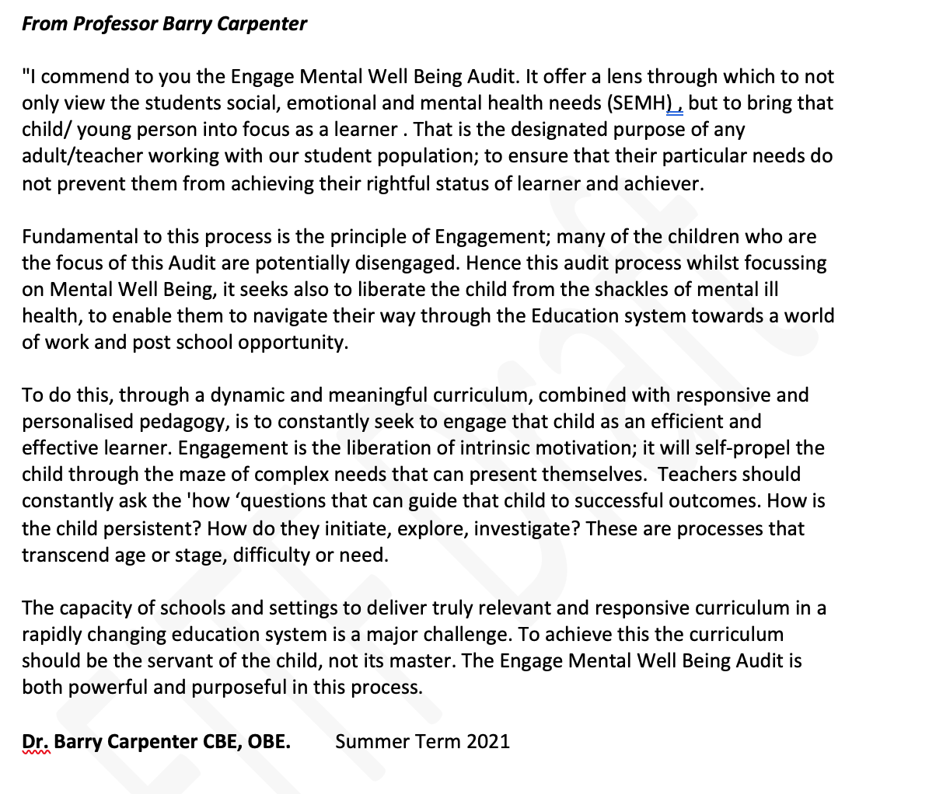

Slide 21
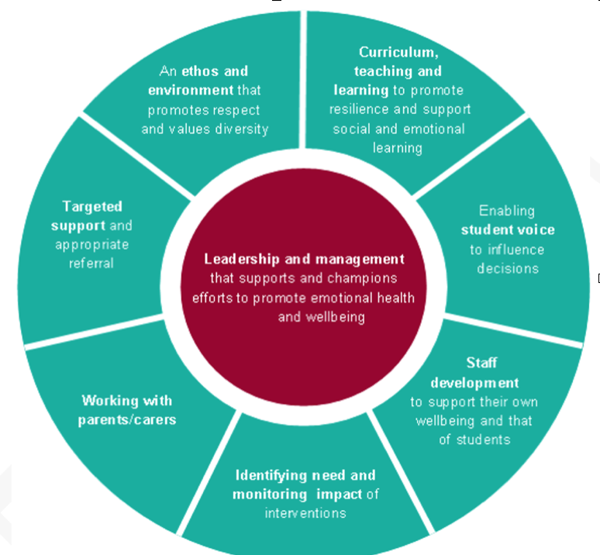
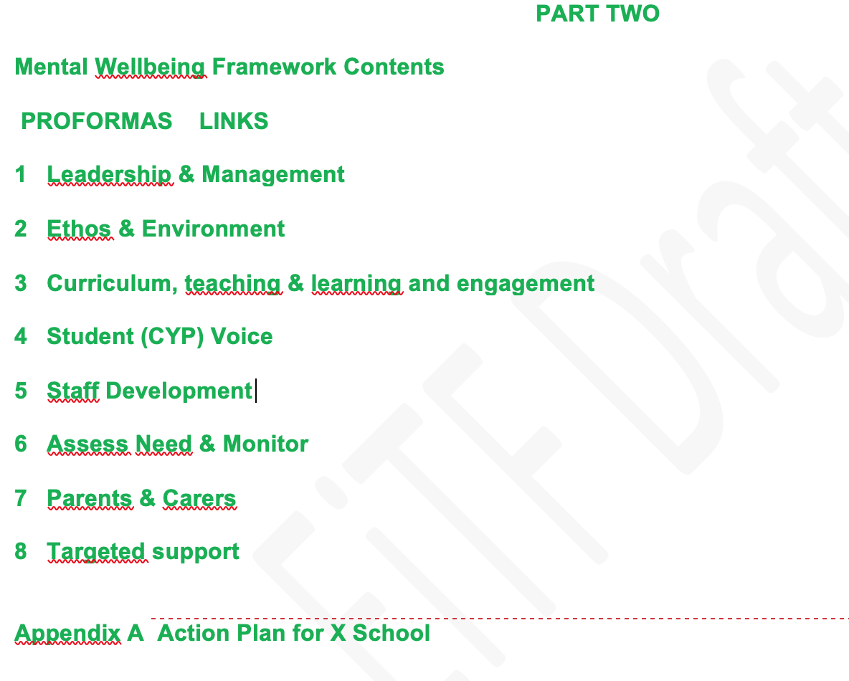

Slide 23
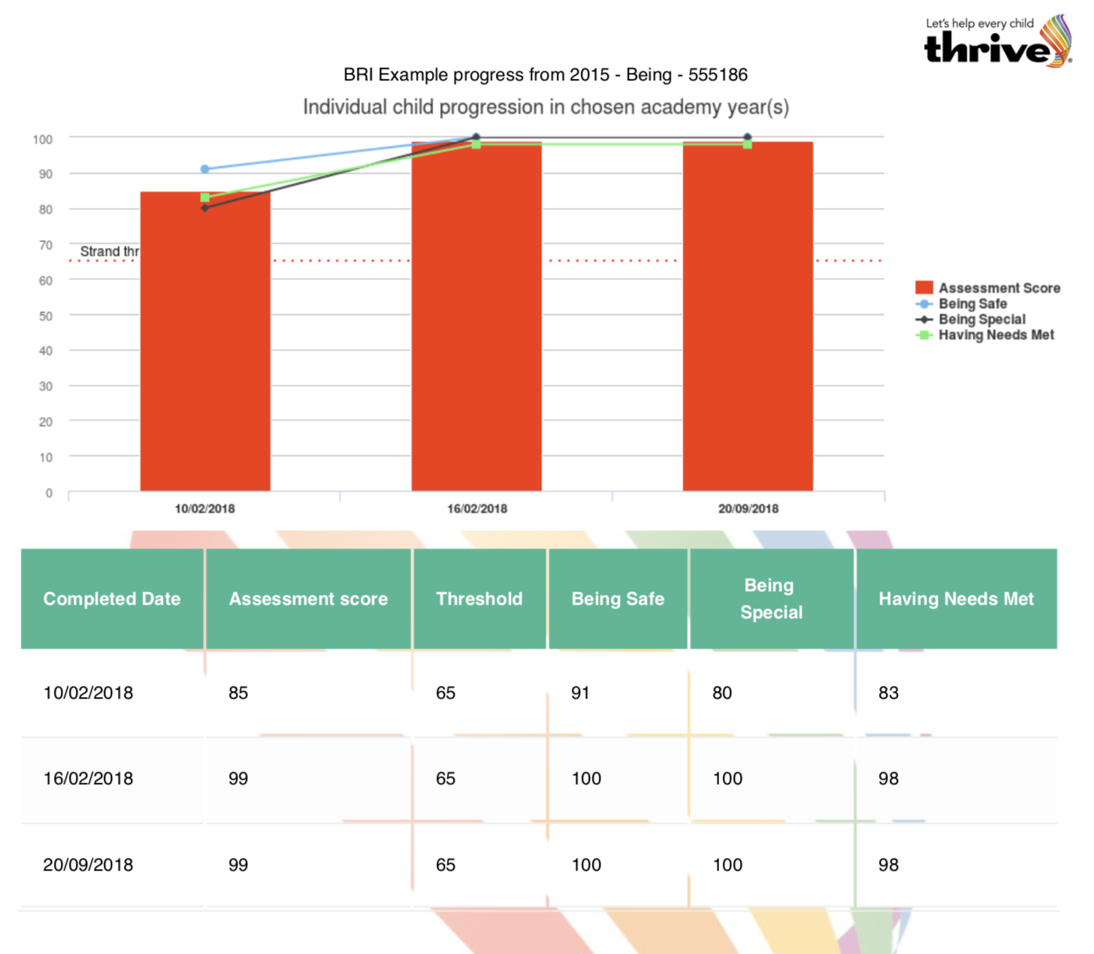

Slide 24
Evidencing Impact

Slide 25
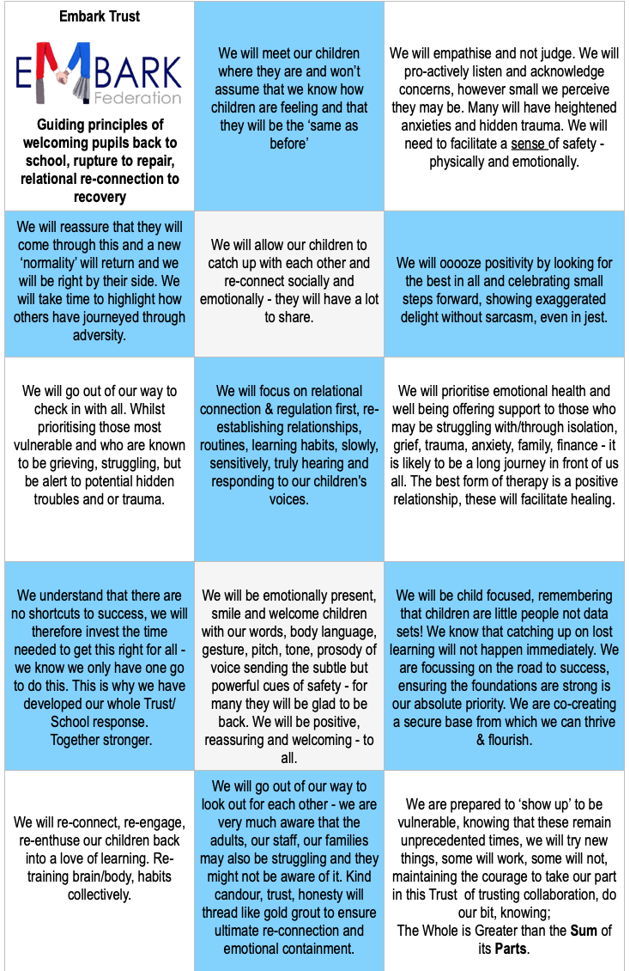
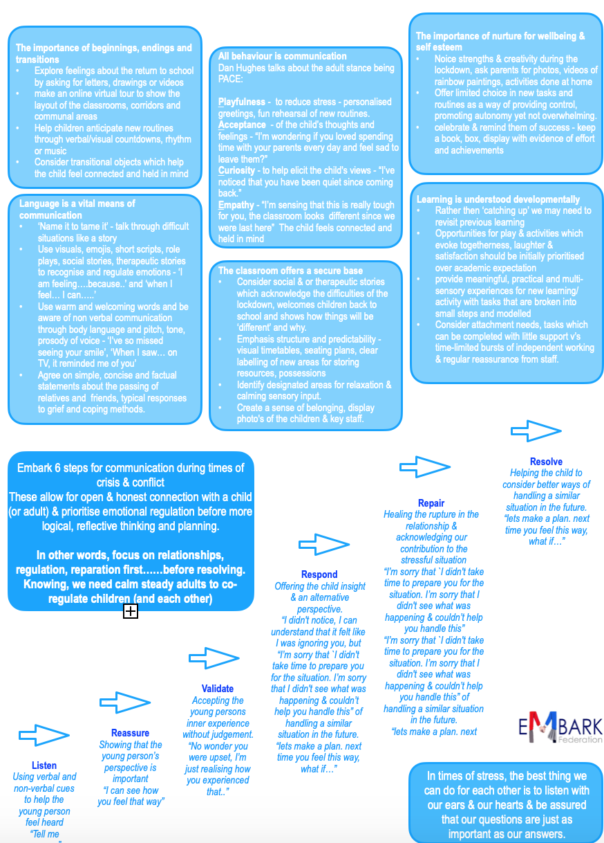
How our adults endeavour to be, the stance we will take in relationship to support each other, our children, families and wider community.
Everyone a leader, everyone a learner, everyone together, together stronger.
Leading from a place of self-awareness rather than self defence
with compassion, empathy, kindness with candour.
A clear shared understanding and relational approach.

Slide 27
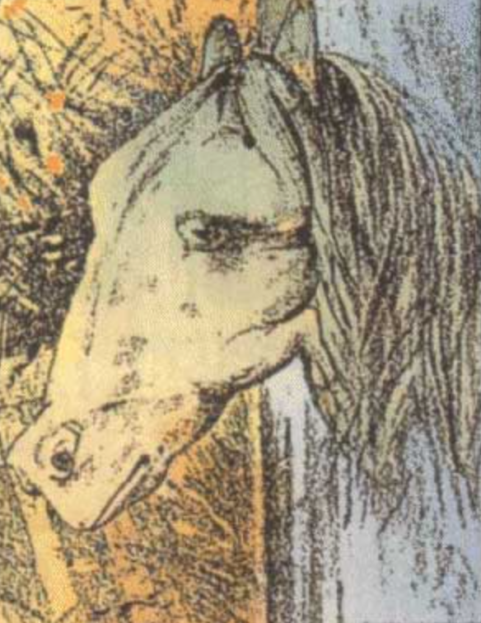
Looking with
fresh eyes??

Slide 28
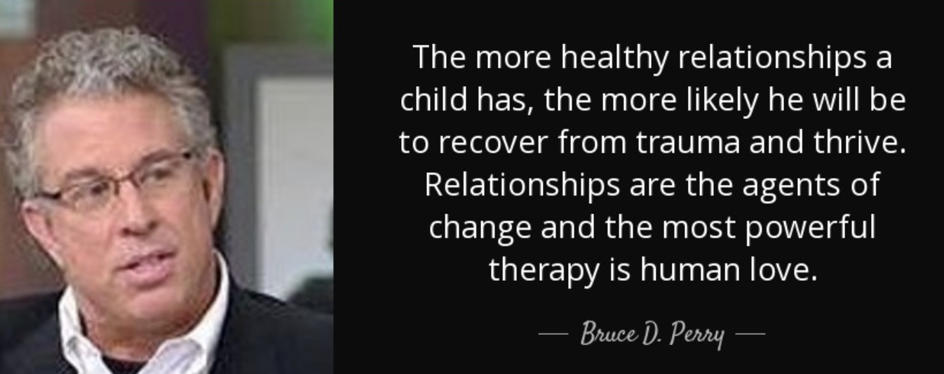
“Children grow to fill the space we create for them, and if it’s big, they grow tall.…I’ve not yet met a child not capable of greatness if given the opportunity and encouragement…………The best present we can give our children is the chance to do something great. It’s a gift that will last a lifetime and transform their lives.”
Thank you.

